Slide 1
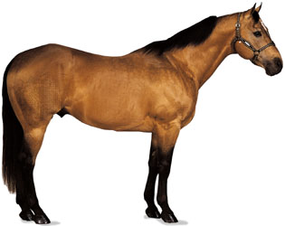
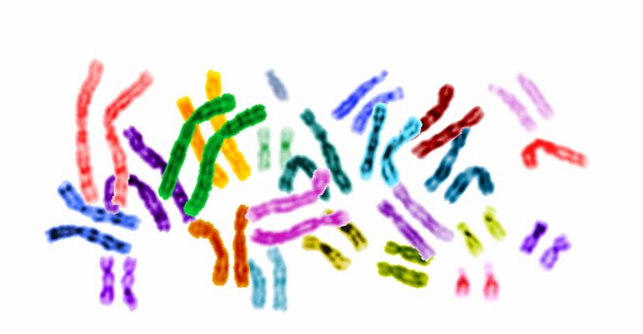
The genome is the genetic material of an animal
It consists of DNA and includes both genes and non-coding sequences
The genome is organized into chromosomes that contain most of the DNA of a living organism
Chromosomes come in pairs
Horses have 31 pairs of autosomes and a pair of sex chromosomes (X and Y)
XX horses are female and XY horses are male

Slide 2
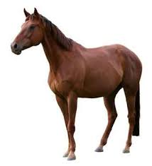
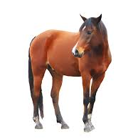
One copy of each chromosome comes from the sire and one copy comes from the dam. There are 4 possible combinations

Slide 3
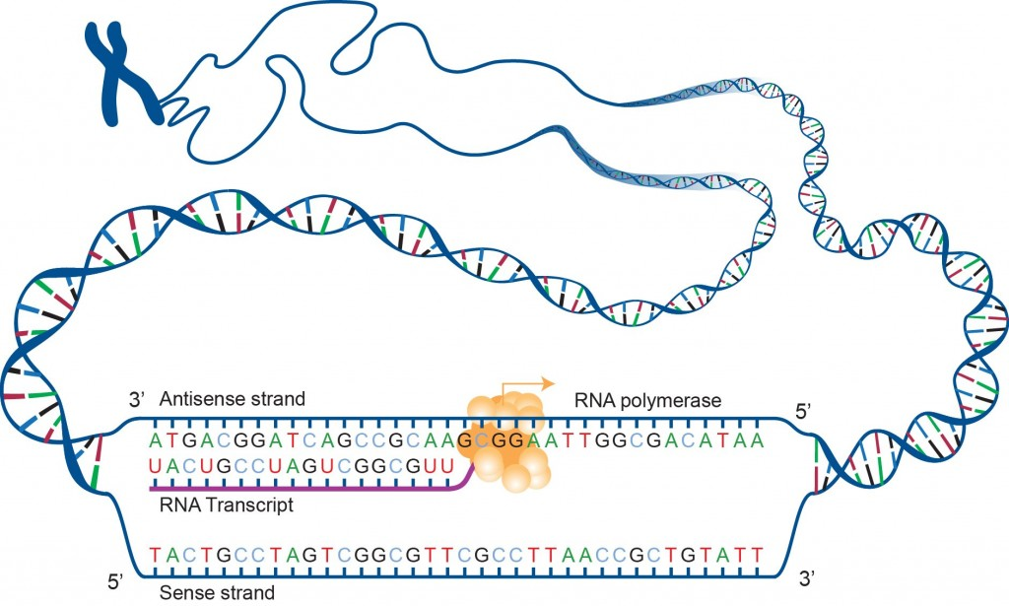
DNA is formed in a double helix. The units that make up the double helix are base pairs. Horses have approximately 2.7 billion base pairs in their genome.

Slide 4
Genes are paired. One copy comes from the sire and one from the dam.
Gene A
Gene B
Gene A
Gene b
Each gene can have several different variations. Each variation is called an allele. Alleles can code for different variations in proteins that can alter traits.
A horse’s combination of alleles is called its genotype. This individual’s genotype is AA Bb.
A genotype where both alleles are the same is homozygous. A genotype were the alleles are different is heterozygous.

Slide 5
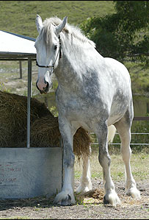
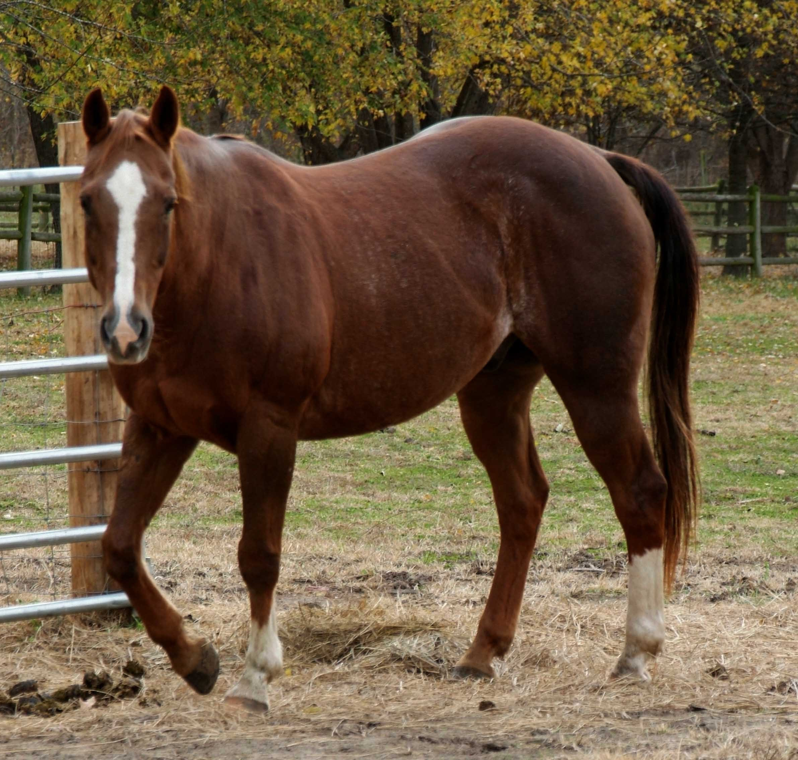
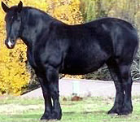
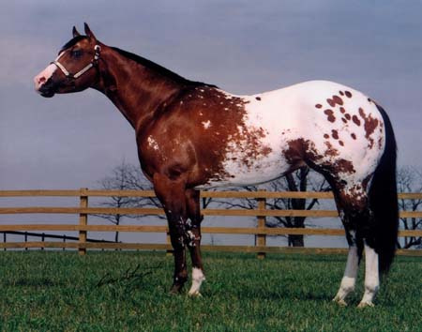
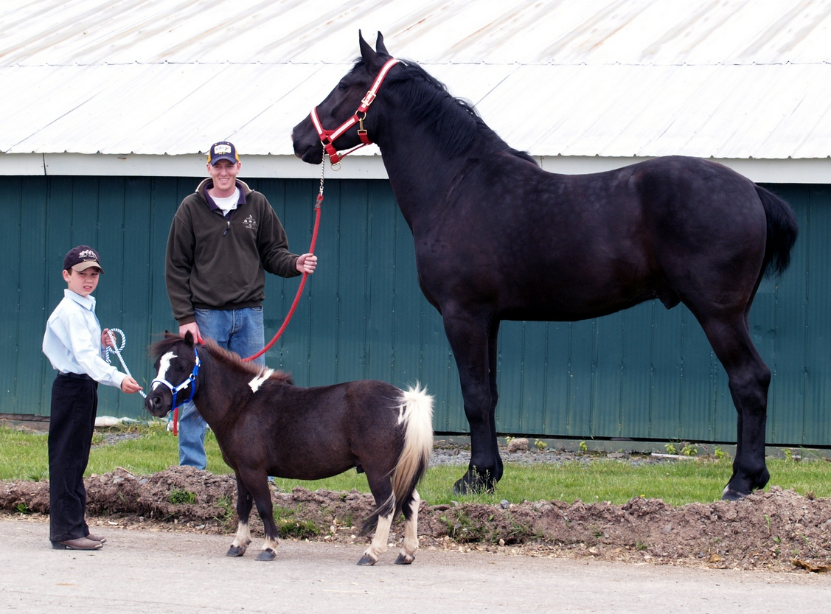
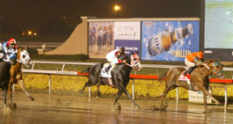
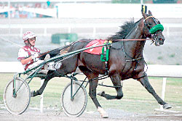
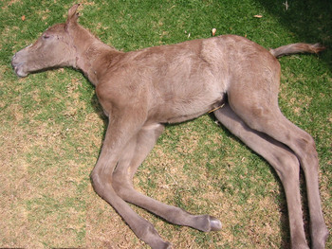
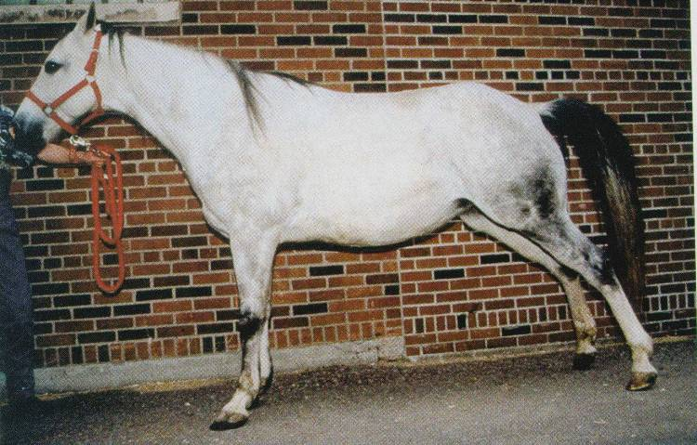
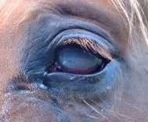
A horse’s phenotype is the traits or characteristics that you see or measure.

Slide 6
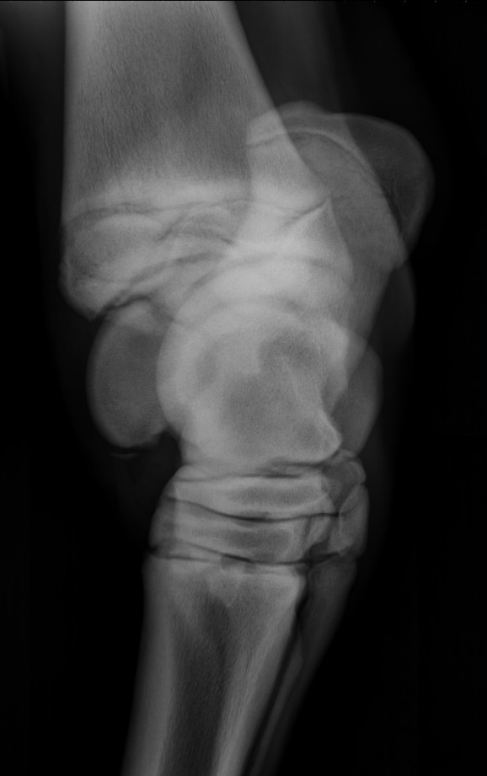
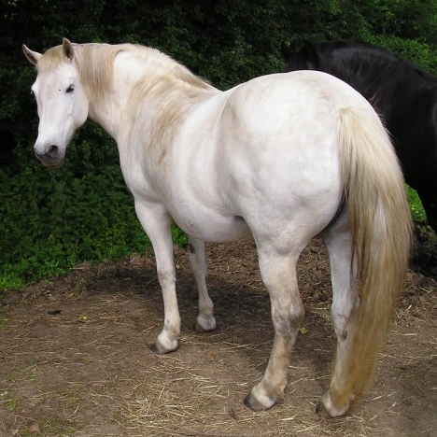
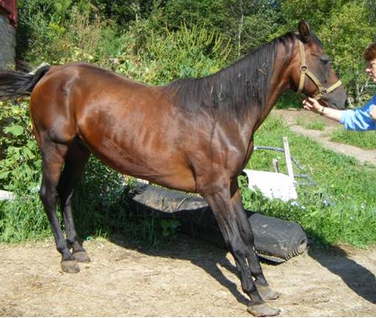
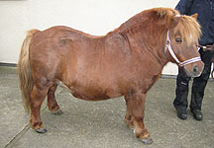
A horse’s genotype affects its phenotype
Phenotype can be the result of the horse’s genotype at a single locus or gene
Single gene or monogenic trait/disease
N/N
G/N or G/G
Phenotype can be the result of the horse’s genotype at many loci or genes
Polygenic trait/disease

Slide 7
General approach to genetic performance or disease
Identify animals with and without phenotype
(100s to 1,000s)
Estimate heritability
Find potential genes
Identify potential mutations (WGS)
Confirm mutations in another cohort
Confirm biologic affect of mutations
Create risk models to predict phenotype
Develop new treatments (disease)

Slide 8
Whole Genome Sequencing
DNA (genome)
Random fragmentation
Sequencing
Mapping
Notes:
8
Rapidly increases the speed with which genetic research can be conducted

Slide 9
Variant Calling
Single nucleotide polymorphisms (SNPs)
G/C
A/T
G/C
T/A
G/C
C/G
A/C
A/G
GENES
INTERGENIC REGIONS

Slide 10
Exons
Introns
T/C
T/A
G/C
A/T
G/C
Variant Effect Prediction

Slide 11
Variant Effect Prediction
T/C
G/C
T/A
A/T
G/C
Prediction requires appropriate gene models
Intron/exon boundaries
Untranslated regions (5’ and 3’)
Problem: gene models are often not correct!

Slide 12
Finding Gene Models
RNA
DNA
What if using RNA doesn’t work?

